Slide 1
FOOTBALL WORLDCUP Data ANALYSIS

Slide 2
Project OUTLINE
Agenda
Problem Identified
Goals & Objectives Of The Analysis
Possible Decisions
Constraints & Restrictions
Data Analysis (3 Visualizations)
Results Interpreted
Additional Research To Be Done
Conclusion

Slide 3
1.
AGENDA

Slide 4
AGENDA
To take out insights from the Football WorldCup Results data.
To come up with conclusions about the matches that have been played since 2003 till 2021.

Slide 5
2. Problem identified

Slide 6
Problem identified
How this data can help us to know the details of the football world cup stats?
Which country’s team has been dominant from start up till now?
What we could infer for the future Football World Cup games?

Slide 7
3. GOALS AND OBJECTIVES OF ANALYSIS

Slide 8
GOALS AND OBJECTIVES OF ANALYSIS
To find out top teams that have performed well in the World Cup games.
To find out the top team with respect to their goals.
To find out top teams with respect to their appearance in finals.
To infer some conclusions about the upcoming World Cup matches.

Slide 9
4. POSSIBLE DECISIONS

Slide 10
POSSIBLE DECISIONS
We will decide how well a particular team can perform according to its previous record.
We will come to know about the required efforts of teams to become competent.
What loop-holes each of the team has to overcome.

Slide 11
5. CONSTRAINTS AND LIMITATIONS

Slide 12
CONSTRAINTS AND LIMITATIONS
The dataset in this project bounds towards the teams collectively.
More details may require to better analyze the World Cup record.

Slide 13
6. DATA ANALYSIS (3 Visualizations)

Slide 14
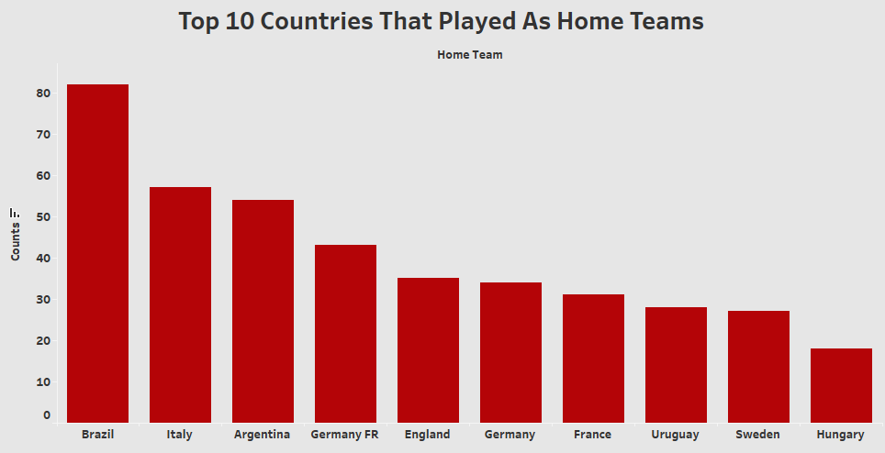
Data Analysis - I

Slide 15
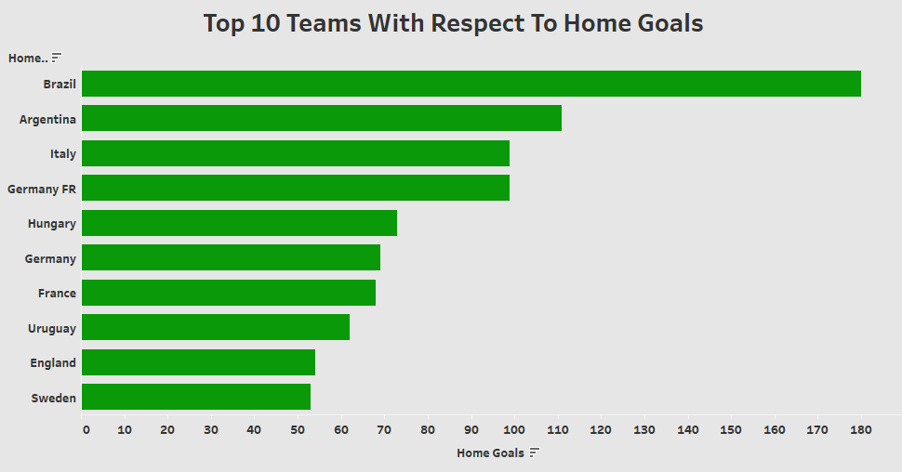
Data Analysis - II

Slide 16
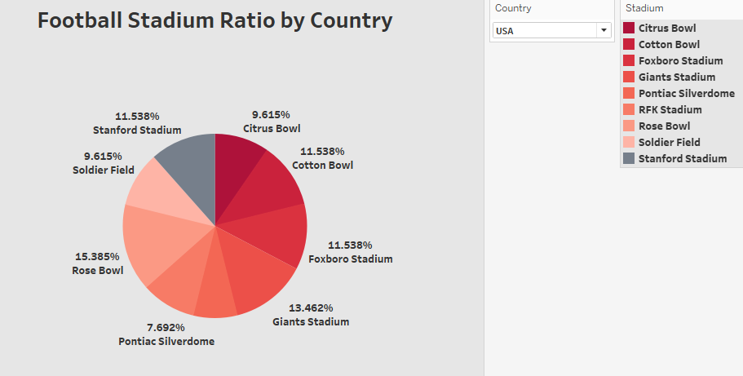
Data Analysis - III

Slide 17
7. RESULTS INTERPRETED

Slide 18
RESULTS INTERPRETED
Brazil tops the table for playing as a home teams since 1930.
The team with most home goals is none another than Brazil.
Ratio of stadiums per country - In USA, the most matches have been played at Rose Bowl Football Ground.

Slide 19
8. ADDiTIONAL RESEARCH TO BE DONE

Slide 20
ADDiTIONAL RESEARCH TO BE DONE
In-depth analysis regarding each and every match.
Analysis of Group Stage matches.
Yearly performance of each country’s team.
Cities in which the matches have been played

Slide 21
9. Conclusion

Slide 22
CONCLUSION
In this project, we have gone through a brief analysis of Football World Cup data.
Our analysis has put light on the performances of teams regarding their goals, wins, and loses.
To conclude, the analysis is well enough, but needs more data regarding critical details about matches.

